Slide 1
Agents SDK
Presenter: 賴彥傑
Date: July 23, 2025

Slide 2
Outline
Introduction
Workflow
Summary

Slide 3
Introduction
Agents: 負責system/instructions和操作工具(Tools)。
Tools: Hosted、Function、Agents as Tools。
Handoffs: 調用不同Agents
Guardrails: 輸入與輸出的過濾器
Tracing: 操作紀錄
https://andy6804tw.github.io/crazyai-llm/llm-practical/openai-agents-sdk-tutorial/

Slide 4
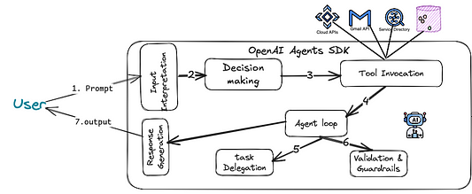
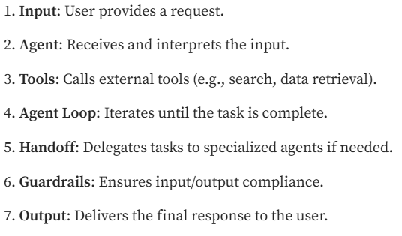

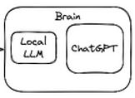
Workflow
https://medium.com/@shamim_ru/openai-agents-sdk-with-local-llm-461c77a5e7fb

Slide 5
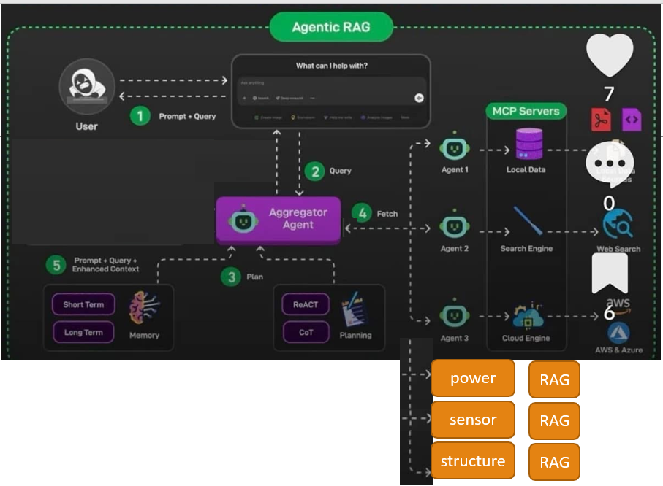
Summary
Handoffs
Tools
/github/LLM_UAV_Design/uav_doc/teacher_docs/reference_materials/Agentic_Rag.jpg

